Slide 1
Python 101

Slide 2
Agenda
Overview
Data structures / Data Types
File I/O
Functions
Conditional statements & Iterations
Strings
Lists & Tuples
Dictionaries
Exception Handling
Data Access from different sources

Slide 3
Python – A Brief history
Invented in the Netherlands, late 80’s/ early 90s by Guido van Rossum
Open source programming tool
Becoming increasingly popular as a Data Science tool over last 3-5 yrs
Many leading companies such as Google use Python heavily
Very active community involved in enhancing functionality of Python

Slide 4
More than just a scripting language
Interpreted at run time
Processed at run time; No need to compile before execution
Interactive
Can execute Python commands real time at the Python prompt
Object Oriented
Wide range of applications from gaming to complex data analytics

Slide 5
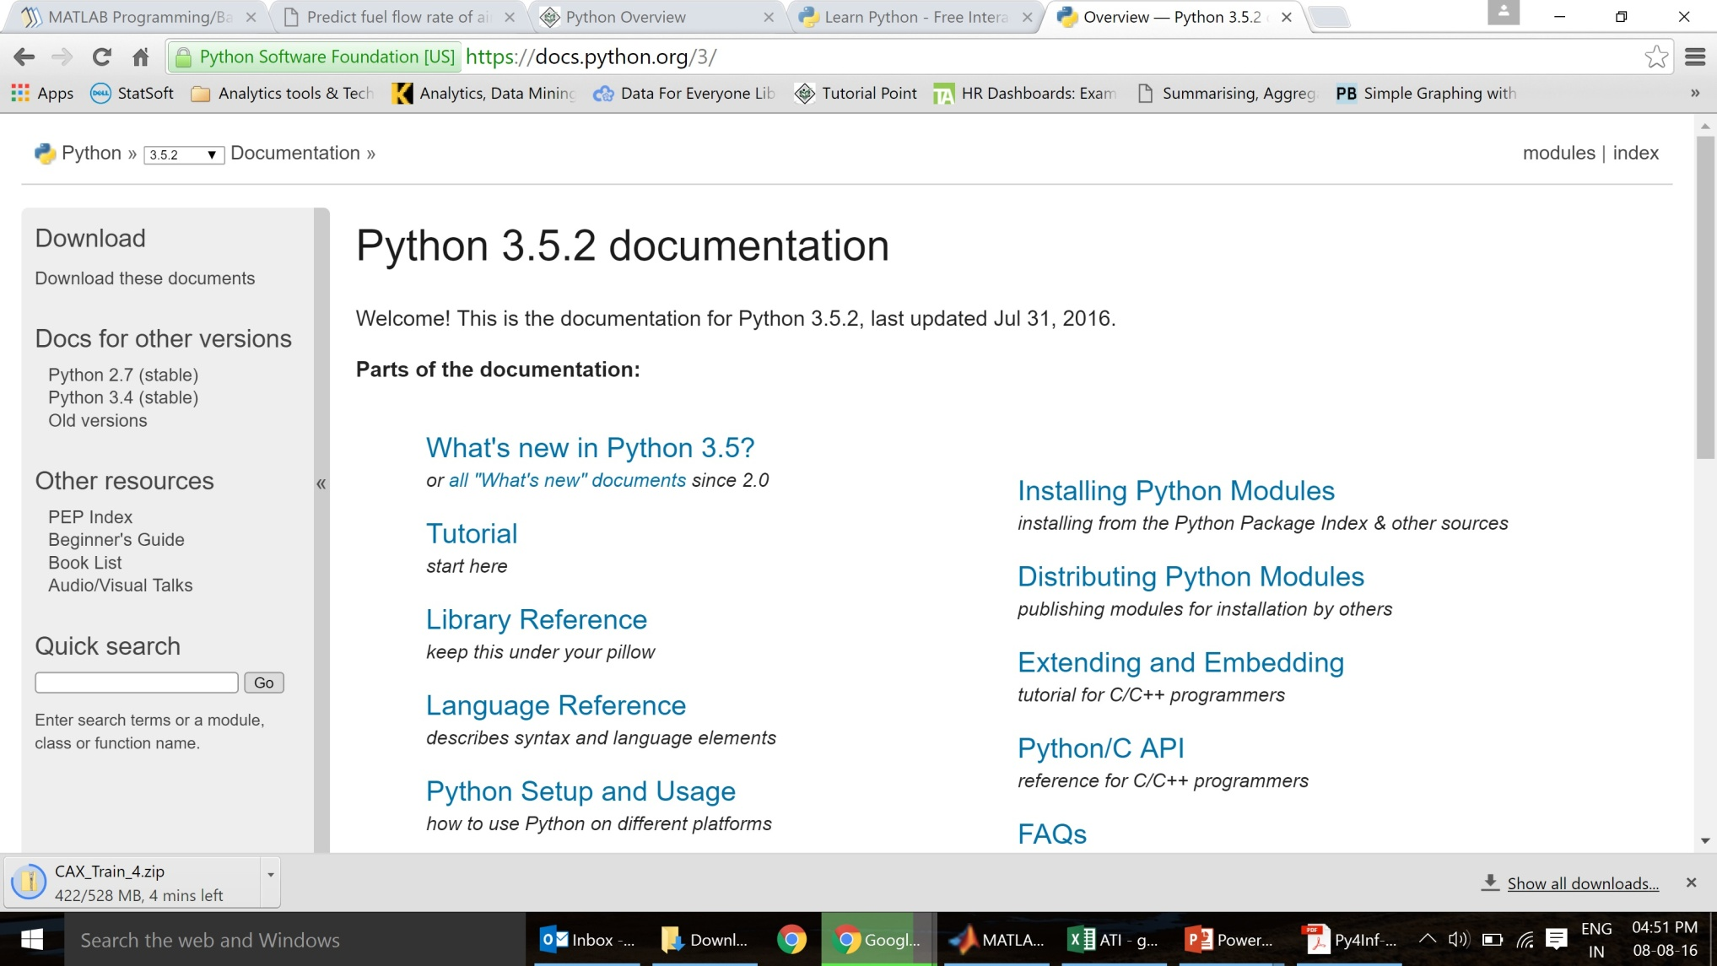
Reference - https://docs.python.org/

Slide 6
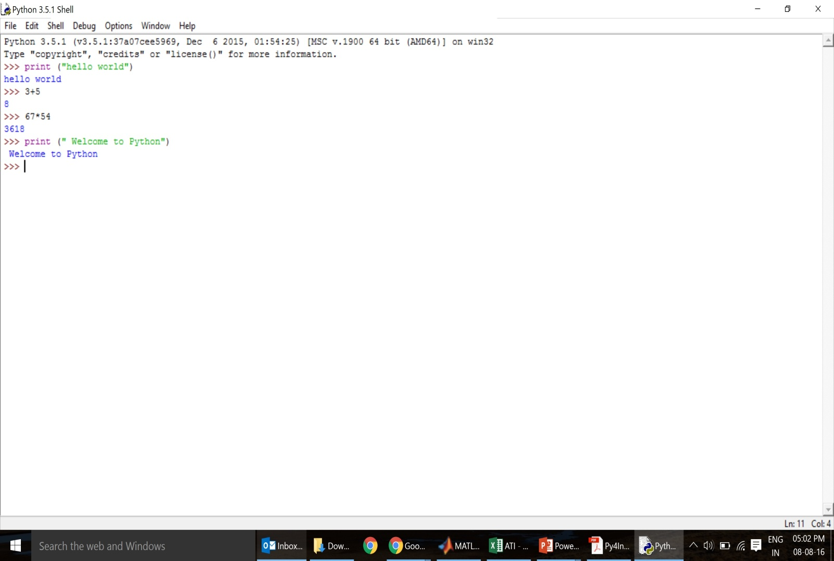
Running Python – Interactive IDLE Shell
Typically used on Windows
Multi-window text editor with syntax highlighting, auto-completion, smart indent etc
Interactive
Can execute Python commands real time at the Python prompt
Good for testing

Slide 7
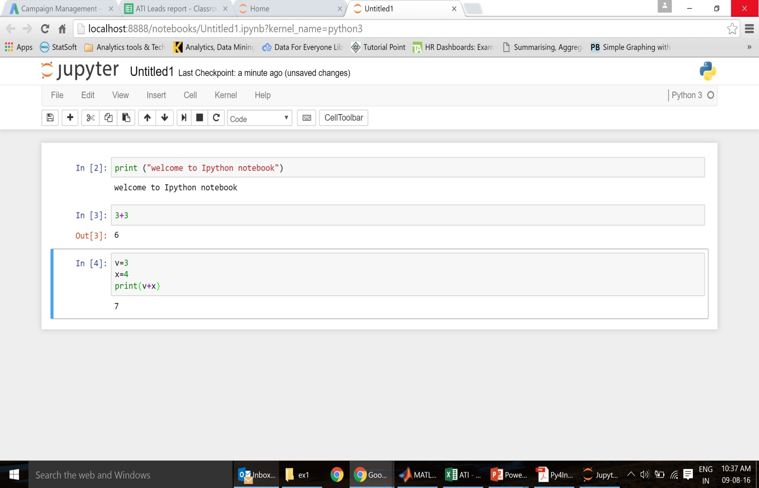
Running Python – Jupyter/Ipython Notebook
Interactive
Good mix between a shell and script file
Ability to run only pieces of a particular code vs everything
Can share workbooks across multiple users
Can see output / code in same file (inline)
Especially useful for plots / complex pieces of code

Slide 8
The Basics

Slide 9
A Sample Python Code
# A Simple Python Program
x = 15 # Assigning a numeric value
y = “Hello” # Assigning a char value
z = 5
if z > 0 or y == “Hello”: # Checking for a condition
x = x + 1 # Value modification
y = y + “ World” # String concatenation
print x
print y
Variable
Operator
Constant
Key Words

Slide 10
Understanding the code
First assignment to a variable creates it
No need to declare variables in the beginning
Python figures out variable types on its own
Assignment: “ = “; Comparison: “ == “
Blocks of code indicated by indentation
Logical operators are words (‘or’, ‘and’), not symbols
‘Print’ – basic printing command
# A Simple Python Program
x = 15
y = “Hello”
z = 5
if z > 0 or y == “Hello”:
x = x + 1 y = y + “ World”
print x
print y

Slide 11
Whitespace
Whitespace is meaningful in Python especially indentation & placement of newlines
Use a newline to end a line of code
Use ‘\’ if you need to go to next line prematurely
No braces {} to mark blocks of code; use consistent indentation instead
First line with more indentation starts a nested block
First line with less indentation is outside of the block
Colons start of a new block in many constructs
First line with less indentation is outside of the block

Slide 12
Variables
Binding a variable in Python means setting a name to hold a reference to an object
No need to declare variables in the beginning
Python figures out variable types on its own
Names do not have an intrinsic data type; objects have types
Python figures out variable types on its own based on what data is assigned to that object

Slide 13







Variables
Other languages
Python
a = 1
Box A is created and value 1 is put in it
a = 1
A reference tag A is placed on integer object 1
a = 2
Box A content (value) is replaced with 2
a = 2
Reference tag is moved from object 1 to object 2
b = a
Another copy of the variable is made and put in a new box B
b = a
Another reference tag b is put on integer object 2

Slide 14
Naming variables
Must start with a letter or underscore_
Must consist of letters, numbers, underscore (no other special characters)
Case Sensitive
Cannot be any of the reserved keywords
Examples
Reserved Keywords
Good: spam, _speed, spam123
Bad: 23Spam, #sign, sign.12
Different: egg, EGG, Egg
and, assert, break, class, continue, def, del, elif, else, except, exec, finally, for, from, global, if, import, in, is, lambda, not, or, pass, print, raise, return, try, while

Slide 15
Assignment Statements
Variable name on the left side, value on the right side
e.g. x = 3
Can assign multiple names at the same time
e.g. x, y = 3, 5
Assignment can be chained
e.g. x = y = z = 5
You can swap values
e.g. x , y = y, x
Note: Variable assignments have local scope unless by using global keyword. Not used very commonly

Slide 16
Assignment Statements – Global vs local scope
Code
Output
def f():
s = “fuction_var"
p="temp"
print s, p
f()
print p
function_var temp
---------------------------------------------------------------------------
NameError
Traceback (most recent call last) <ipython-input-23-754699070ec8> in <module>() 6 7 f() ----> 8 print (p)
NameError: name 'p' is not defined
def f():
s = “fuction_var"
global p
p="temp"
print s, p
f()
print p
function_var temp
temp

Slide 17
Data Types in Python
Numbers
Integers: e.g. 100, 25
Floats: e.g. 3.14, 6.52
Strings
Can use “ ” or ‘ ’ to specify strings E.g. “abc” is the same as ‘abc’
Unmatched quote can be within a string E.g. “a’bc”
Lists, Tuples, Dictionaries (covered in detail in a later section)
Use inbuilt function type() to determine the type of object
x=5
y='hello'
print type(x)
print type(y)
< class ‘int’ >
< class ‘str’ >

Slide 18
Type conversions
int() – Convert to integer
float() – Convert to float
str() – Convert to string
Note: to convert a string to int or float, values should be numeric

Slide 19
Numeric Operations
Operation precedence
Operator | Operations
+ | Addition
- | Subtraction
* | Multiplication
/ | Division
** | Power
% | Remainder
Brackets
Power
Division / Multiplication
Addition / Subtraction
Left to Right

Slide 20
Files I/O

Slide 21
Printing to the screen
Basic command is ‘print’
Can print multiple items separated by commas
E.g. print (x,y)
Code
Output
x = 10
Y = 100
print (x)
print (y)
print (x,y)
10
100
10 100

Slide 22
Getting user input from the keyboard
Python can be made to pause and get input from the user
raw_input function can be used for this
Note: raw_input function returns a string

Slide 23
Opening & Reading Files
Files can be opened using open() function
open() returns a handle that is used to manipulate the file
Handle is a reference to the file that needs to be acted upon
With the open() command, the file is not read but kept ready for further action
file_obj = open(file_name, ‘access mode’)
file obj: Stores the handle that is returned by the open()
file_name: name of the file to be opened
access mode: Mode in which you want file to be opened
commonly used modes are
(‘r’ – read, ‘r+ ‘ – read & write with pointer at beginning of file,
‘w’ – write, ‘w+’ – read & write with pointer at beginning of file, ‘a+’ – append & read)

Slide 24
Reading Files
read() reads from an open file as a single string
Not usually used unless file size is known upfront
Reads from the be ginning till end of file.
tell() & seek() used to set the position of the pointer in the file
tell() indicates the current position of the pointer in the file
seek() allows you to set the position of the pointer in the file
seek (offset, from):
Offset is the number of characters you want to move the pointer by
From is the reference position; valid values are 0 (beginning of file), 1 (current position), 2 (end of file)

Slide 25
Writing to files
write() writes any string to an open file
write (‘string’) where ‘string’ is the content to be written to the file
close() – closes the file

Slide 26
Functions

Slide 27
Functions Overview
Reusable code that takes argument(s) as input, does some computation & returns a result
Function is defined using the def keyword
Def keyword followed by function name and parentheses
Any input parameters / arguments are placed inside these parentheses
Code block for every function starts with colon (:) and is indented
Any expression passed back is done using the return keyword
Function is invoked using the function name and the required arguments in parentheses

Slide 28
Function definition
Syntax:
Arguments:
If an argument is specified when defining the function, then this has to be provided when invoking the function
Parameters have positional behavior; order of passing parameter must be the same as definition unless explicitly calling keyword (name) of the parameter
Default parameters can be specified to be used if parameter passed is null
def function_name(parameters or arguments):
Python code
return

Slide 29
Functions
Syntax:
Arguments:
If an argument is specified when defining the function, then this has to be provided when invoking the function
Parameters have positional behavior; order of passing parameter must be the same as definition unless explicitly calling keyword (name) of the parameter
Default parameters can be specified to be used if parameter passed is null
def function_name(parameters or arguments):
Python code
return

Slide 30
Anonymous functions
Anonymous functions are functions created at run time and not bound to a name
Used when there is a need for a small function that will not be used regularly
Uses the lambda keyword
Lambda functions return a value in the form of an expression.
Syntax: lambda [arg1 [,arg2,.....argn]]:expression
e.g. X = lambda a, b : a+b
X stores the value returned by the lambda function
a & b are the arguments passed
a+b is the expression computed by the function and returned

Slide 31
Conditional statements

Slide 32
Conditional statements
Similar to other programming languages – checks for whether a particular condition is true/false and executes certain commands as specified
Types of conditionals
One way decisions -- If, Nested if statements
Two way decisions – If-Else,
Multi-way decisions – If-Elif-Else
Comparison Operators
Operator | Meaning
< | Less than
<= | Less than or equal
== | Equal
Operator | Meaning
> | Greater than
>= | Greater than or equal
!= | Not Equal

Slide 33
One Way & Two Way decisions
One Way Decisions:
Two Way Decisions:
Simple If
Nested If
if (comparison condition):
Python code
if (comparison condition):
Python code
if (comparison condition):
python code
if (comparison condition):
Python code
if (comparison condition):
Python code
else:
Python code

Slide 34
Multi-Way decisions
Multi-Way Decisions:
if (comparison condition):
Python code
elif (comparison condition):
Python code
elif (comparison condition):
Python code
elif (comparison condition):
Python code
else:
Python code

Slide 35
Loops & Iterations

Slide 36
What are loops?
Loops are statements that
A) go through a set of statements/conditions until a particular condition is met or
B) go through a certain number of iterations and executes some statements
Loop A above is called an indefinite loop
Loop continues until a certain condition is met
If code is not written correctly, this condition may never be met
Loop B above is called a definite loop
Loop continues only for a certain specified number of iterations

Slide 37
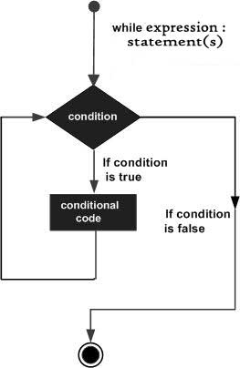
While loops
While loop repeatedly executes a set of target statements as long as a given condition is true
Syntax
while expression:
statement(s)
Example
count = 0
while (count < 9):
print 'The count is:', count
count = count + 1
print "Good bye!"

Slide 38
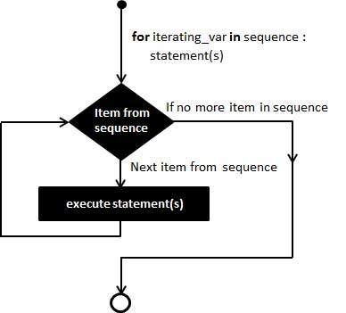
For Loops
For loop executes a set of target statements for a certain specified set of iterations
Syntax
for [iteration expression]:
statement(s)
Example
count = 0
for i in [0,1,2,3,4,5]:
print 'The count is:', count
count = count + 1
print "Good bye!"

Slide 39
Iterators
Iterators can be used in many ways in Python
As a list
As letters of a string
for i in [0,1,2,3,4,5]:
print 'The count is:', count
count = count + 1
print "Good bye!"
for letter in “PYTHON”:
print 'The current letter is:', letter
Using the range () function
for i in range(1,5):
print 'The current number is:', i
Note: range (1:5) will take numbers 1,2,3,4 only. Excludes the last number
for i in range(5):
print 'The current number is:', i
Note: range (5) will take 5 consecutive numbers starting from 0

Slide 40
Loop Modifications – Break & Continue
Break can be used if we want to break out of a loop before its full completion
Continue ends the current iteration and jumps to the beginning of the loop to start the next iteration
Example for break
Example for continue
for i in [0,1,2,3,4,5]:
print 'The count is:', count
count = count + 1
if count > 3:
break
print "Good bye!"
for i in [0,1,2,3,4,5]:
if i<5
continue
print 'The count is:', count
count = count + 1
print "Good bye!"

Slide 41
Strings

Slide 42
Looking Inside Strings
String is a sequence of characters
A string is defined using quotes (single or double)
“hello” is the same as ‘hello’
We can extract any character in a string by using the Index number
Index (in Python) always starts at zero and is an integer
Fruit = “BANANA”:
Letter = fruit[2]
print letter
Letter = fruit[0]
print letter
B | A | N | A | N | A
0 | 1 | 2 | 3 | 4 | 5
-6 | -5 | -4 | -3 | -2 | -1
N
Pos index
B
neg index

Slide 43
Basic string operations
‘ + ‘ means concatenate in strings
E.g. “Hello” + “ Python” → “Hello Python”
‘ * ‘ means repetition. Creates a new string by concatenating multiple copies
E.g. 4 * ”hi” = “hihihihi”
‘in’ & ‘not in’ keywords
‘ in ‘ returns True if a character is in the string
‘ not in ‘ returns True if a character is not in the string

Slide 44
String functions
Len function gives the length of strings
E.g. len(‘banana’) = 6
Slicing strings
Extract a part of the string using the colon ( : ) operator
Fruit = “BANANA”:
Fruit [2:4]
Fruit [:5]
Fruit[2:]
Fruit [:]
NA
BANAN
NANA
BANANA
B | A | N | A | N | A
0 | 1 | 2 | 3 | 4 | 5

Slide 45
String functions
String library is a list of inbuilt string methods
Can be invoked by appending the method to the string variable
These functions do not modify the original string; they return a new string
dir(str) gives a list of all available string methods
['capitalize', 'casefold', 'center', 'count', 'encode', 'endswith', 'expandtabs', 'find', 'format', 'format_map', 'index', 'isalnum', 'isalpha', 'isdecimal', 'isdigit', 'isidentifier', 'islower', 'isnumeric', 'isprintable', 'isspace', 'istitle', 'isupper', 'join', 'ljust', 'lower', 'lstrip', 'maketrans', 'partition', 'replace', 'rfind', 'rindex', 'rjust', 'rpartition', 'rsplit', 'rstrip', 'split', 'splitlines', 'startswith', 'strip', 'swapcase', 'title', 'translate', 'upper', 'zfill']

Slide 46
Commonly used methods
strip([chars]), lstrip([chars]), rstrip([chars])
Removes whitespace for specified (optional) number of characters
strip() removes whitespace from both beginning and end of string
lstrip() removes whitespace at beginning of string
rstrip() removes whitespace at end of string
upper & lower
Converts entire string into upper or lower case
Usually used when searching / comparing strings to avoid errors due to case sensitivity
split([str = “ “])
Splits string into substrings based on delimiter specified (default is space)

Slide 47
Commonly used methods
count(str, [beginning, end])
Counts number of occurrences of a particular string / character
find(str, [beginning, end])
Finds the first occurrence of a substring within a string and returns its position
If substring not found, returns -1
replace(str old, str new [, max n])
Replaces all instances of a substring with new substring
Optional: specify max number of instances to be replaced else all instances will be replaced

Slide 48
Commonly used methods
startswith(str, [beginning, end])
Determines if string is starting with given substring. Returns true is yes
endswith(str, [beginning, end])
Determines if string is ending with given substring. Returns true is yes
splitlines()
Splits lines at all new lines (\n) and returns a list of each line

Slide 49
String formatting
Typically used for print statements
%s - String (or any object with a string representation, like numbers)
%d - Integers
%f - Floating point numbers
% . <number of digits>f - Floating point numbers with a fixed amount of digits to the right of the dot.

Slide 50
Lists & Tuples

Slide 51
Lists
Lists is a sequence data type; defined between [ ]
It is a sort of ‘collection’ – many independent values can be put into one variable
Lists can contain objects of different types
List element can be any data type; even another list
A list can also be empty
Similar to strings, list elements can be extracted using its index value
Lists are mutable i.e. elements of a list can be updated with new values

Slide 52
List functions
len (list)
Returns the number of elements in the list
range (x:y), range(x)
range (x,y): Returns a list of numbers ranging from x to y-1 or
range (x): x elements starting from 0
Concatenate lists using ‘ + ‘; Repeat list elements using ‘ * ‘
Slicing lists similar to strings using [ : ]
Max (list), min (list), sum(list) to get max, min, sum of elements in the list

Slide 53
List methods
List methods can be invoked by appending the method to the list variable
['append', 'clear', 'copy', 'count', 'extend', 'index', 'insert', 'pop', 'remove', 'reverse', 'sort']
Similar to strings, ‘in’ and ‘not in’ operators can be used to determine if an element is part of a list

Slide 54
Commonly used List methods
append (object)
Appends Object to the list
count(object)
Counts how many times the object appears in the list
reverse()
Reverses the order of objects in the list
sort()
Sorts objects in the list

Slide 55
Tuples
Tuples are similar to lists but are immutable objects
Defined between ( )
Tuples can be defined by putting in values separated by commas
To define a single tuple, comma still has to be included e.g. X=(50,)
Tuple is more memory efficient (as they are immutable)
Similar to lists, tuple elements can be extracted using its index value
Only two tuple methods - [ 'count', 'index']

Slide 56
Dictionaries

Slide 57
Dictionaries
Dictionaries are a set of key – value pairs; dictionary is defined within { }
Unlike lists, dictionaries cannot be accessed by sequence / index; dictionary values are accessed by the key
A dictionary can be empty
Example
Purse = dict()
Purse [‘money’] = 15
Purse [‘candy’] = 3
Purse [‘tissues’] = 50
Print Purse
Print Purse [‘tissues’]
{'tissues': 50, 'money': 15, 'candy': 3}
50

Slide 58
Iterating through dictionaries
A for loop can go through all the keys in a dictionary and look up the values
You can also use the items function
purse = {money’:15, ‘candy’:5, ‘tissues’:50}
for key in purse:
print key, purse[key]
purse = {money’:15, ‘candy’:5, ‘tissues’:50}
for key, value in purse.items():
print key, value

Slide 59
get() method
get() method can check if a key is already in a dictionary and assume a default value if it is not there
Using if else
Using get()
if name in counts:
x=counts[name]
else:
x=0
x= counts.get(name,0)

Slide 60
Creating lists from dictionaries
Use items (), keys(), values() methods
Example
Purse = {‘money’:12, ‘candy’:3, ‘tissues’:50}
list_items = [(k,v) for k,v in purse.items()]
list_keys = [k for k in purse.keys()]
list_values = [v for v in purse.values()]
[('tissues', 50), ('money', 15), ('candy', 3)]
['tissues', 'money', 'candy']
[50, 15, 3]

Slide 61
Creating dictionaries from lists
Use zip() & dict() function
Example
dishes= [‘pizza’, ‘paella’, ‘hamburger’, ‘roti’]
countries = [‘Italy’, ‘Spain’, ‘USA’, ‘India’]
ctry_dishes = zip(countries, dishes)
ctry_dishes_dict = dict(ctry_dishes)

Slide 62
Sets

Slide 63
Sets
Sets are unordered lists with no duplicate entries
x = set([‘London’, ‘Paris’, ‘Mumbai’, ‘New York’, ‘London’, ‘New York’])
print x
{'Mumbai', 'Paris', 'London', 'New York'}

Slide 64
Set Operations
Union combines two sets together and removes duplicate entries
Intersection gets the common values across two sets
Difference gets the values which are in only 1 set
party1=set(['Jack', 'Jill', 'Humpty', 'Dumpty', 'Mary'])
party2 = set(['Humpty', 'Mary', 'Jill‘, ‘Pinochio])
party1.union(party2)
{'Jack', 'Humpty', 'Dumpty’, 'Mary', 'Jill', 'Pinochio'}
party1.intersection(party2)
{'Humpty', 'Mary', 'Jill'}
party1.symmetric_difference(party2)
{'Jack', 'Pinochio', 'Dumpty'}
party1.difference(party2)
{'Jack', 'Dumpty'}
party2.difference(party1)
{'Pinochio'}

Slide 65
Dates & Time Functions

Slide 66
Date / Time functions
datetime module in Python for working with dates and time
Dates & times are stored in python as a datetime object
Methods with datetime
'date', ‘datetime’, ‘time’, ‘timedelta’, ‘tzinfo’
Methods available with datetime.datetime
'astimezone', 'combine', 'ctime', 'date', 'day', 'dst', 'fromordinal', 'fromtimestamp', ‘hour', 'isocalendar', 'isoformat', 'isoweekday', 'max', 'microsecond', 'min', 'minute', 'month', 'now', 'replace', 'resolution', 'second', 'strftime', 'strptime', 'time', 'timetuple', 'timetz', 'today', 'toordinal', 'tzinfo', 'tzname', 'utcfromtimestamp', 'utcnow', 'utcoffset', 'utctimetuple', 'weekday', 'year'

Slide 67
Date / Time functions
E.g.
d = datetime.datetime.today() → value of d = datetime.datetime(2016, 8, 17, 23, 8, 57, 985000)
d.hour → 23,
d.weekday() → 2
d.strftime('%Y-%m-%d') → '2016-08-17‘
d.strftime(‘%H:%M:%S’) → '23:08:57'
Time Delta
now = datetime.datetime.now() → 2016-08-17 23:25:08.260000
yestday = now - datetime.timedelta(days=1)
Tmrw = now + datetime.timedelta(days=1)
Last_week = now - datetime.timedelta(weeks=1)

Slide 68
Date comparisons
date1 = datetime(2016, 8,17)
date2 = datetime(2016, 7,17)
date2> date1 → false

Slide 69
Exception handling

Slide 70
Types of exceptions
EXCEPTION NAME | DESCRIPTION
Exception | Base class for all exceptions
StopIteration | Raised when the next() method of an iterator does not point to any object.
SystemExit | Raised by the sys.exit() function.
StandardError | Base class for all built-in exceptions except StopIteration and SystemExit.
ArithmeticError | Base class for all errors that occur for numeric calculation.
OverflowError | Raised when a calculation exceeds maximum limit for a numeric type.
FloatingPointError | Raised when a floating point calculation fails.
ZeroDivisonError | Raised when division or modulo by zero takes place for all numeric types.
AssertionError | Raised in case of failure of the Assert statement.
AttributeError | Raised in case of failure of attribute reference or assignment.
EOFError | Raised when there is no input from either the raw_input() or input() function and the end of file is reached.
EXCEPTION NAME | DESCRIPTION
ImportError | Raised when an import statement fails.
KeyboardInterrupt | Raised when the user interrupts program execution, usually by pressing Ctrl+c.
SystemError | Raised when the interpreter finds an internal problem, but when this error is encountered the Python interpreter does not exit.
SystemExit | Raised when Python interpreter is quit by using the sys.exit() function. If not handled in the code, causes the interpreter to exit.
ValueError | Raised when the built-in function for a data type has the valid type of arguments, but the arguments have invalid values specified.
RuntimeError | Raised when a generated error does not fall into any category.
NotImplementedError | Raised when an abstract method that needs to be implemented in an inherited class is not actually implemented.

Slide 71
Try & Except
You surround a complex section of code with try & except
If code in try works, - except section is skipped
If code in try fails, - except section is executed
Str_input = raw_input(‘Enter a number: ‘)
Try:
val = int(str_input)
Except:
val = -1
If val > 0:
print ‘Thanks for entering correctly’
Else:
print ‘Not a number; Enter correctly’

Slide 72
Accessing data from different sources

Slide 73
Accessing web data
Using authorized API’s
Twitter, Google etc
Webscraping tools
Beautiful soup
Scrappy
Etc…

Slide 74
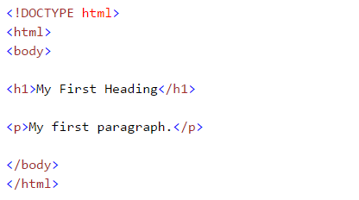
HTML basics
<!DOCTYPE html> : HTML documents must start with a type declaration
HTML document is contained between <html> and </html>
The visible part of the HTML document is between <body> and </body>
HTML headings are defined with the <h1> to <h6> tags
HTML paragraphs are defined with the <p> tag
HTML links are defined with the <a> tag,
“<a href=“http://www.test.com”> This is a link for test.com</a>”
HTML tables are defined with<Table>, row as <tr> and rows are divided into data as <td>

